Slide 1

PRODUCT PORTFOLIO
Quality Pharmaceuticals for Everyday Health
BEKRA PHARMA
www.bekrapharma.com

Slide 2
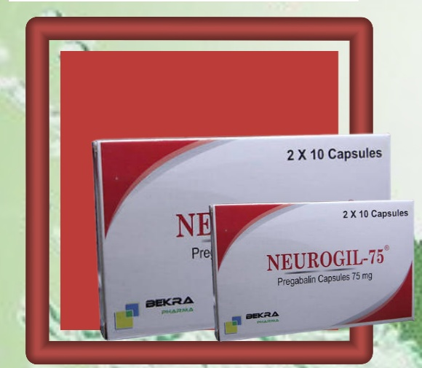
01
NEUROGIL®
PREGABALIN CAPSULES 75 MG
A nerve-pain medication that calms overactive nerve signals — used to manage neuropathic pain and support certain nerve-related conditions.
www.bekrapharma.com

Slide 3
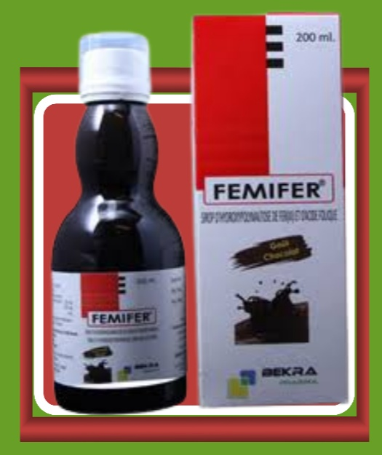
02
FEMIFER®
IRON (FERROUS) & FOLIC ACID SYRUP
An iron and folic acid supplement that supports healthy red blood cell production — helping prevent and treat iron-deficiency anaemia, especially in women.
www.bekrapharma.com

Slide 4
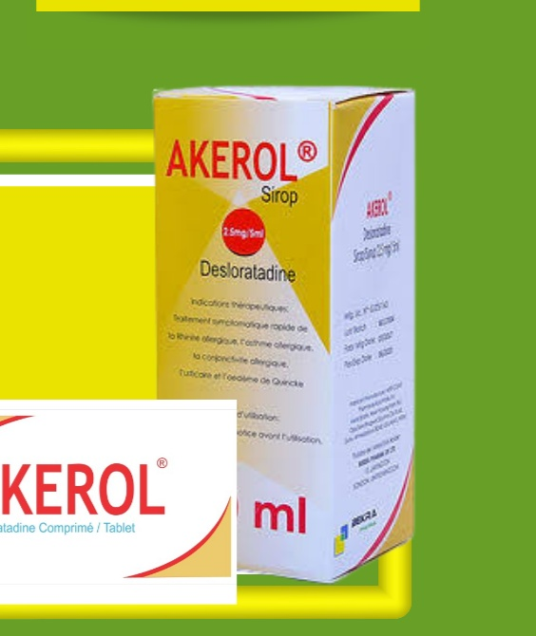
03
AKEROL®
DESLORATADINE
A fast-acting antihistamine that relieves allergy symptoms such as sneezing, itching, and a runny or blocked nose — for both allergic rhinitis and hives.
www.bekrapharma.com

Slide 5
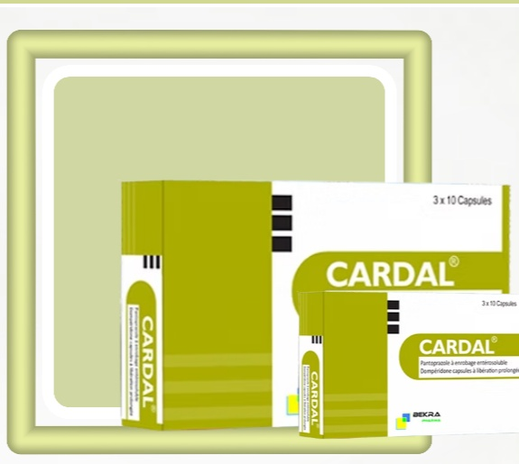
04
CARDAL®
PANTOPRAZOLE / DOMPERIDONE
A combined acid-reducer and motility aid that eases heartburn, acid reflux, and stomach discomfort while helping food move smoothly through the gut.
www.bekrapharma.com

Slide 6
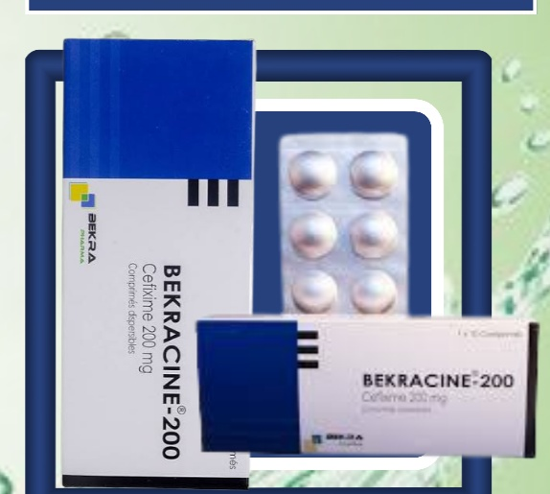
05
BEKRACINE
CEFIXIME 200 MG
A broad-spectrum antibiotic used to treat a wide range of bacterial infections, including those of the respiratory tract, ears, and urinary system.
www.bekrapharma.com

Slide 7
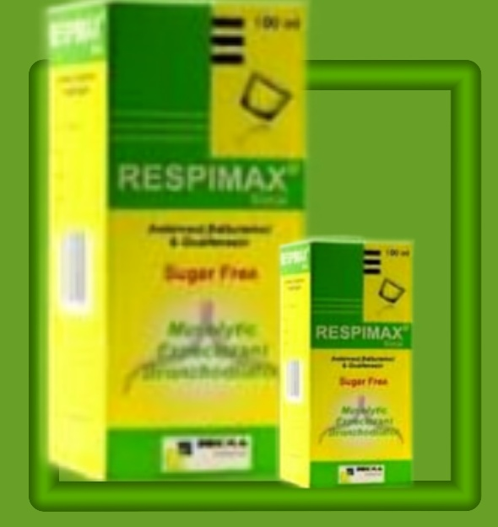
06
RESPIMAX®
SALBUTAMOL, GUAIPHENESIN, AMBROXOL
A sugar-free respiratory syrup that relieves cough while helping clear mucus and open the airways — easing breathing during colds, bronchitis, and chest congestion.
www.bekrapharma.com

Slide 8
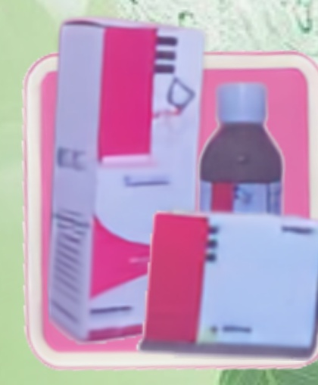
07
FUCANOL®
FLUCLOXACILLIN
A targeted antibiotic effective against staphylococcal infections — commonly used for skin, soft tissue, and other bacterial infections.
www.bekrapharma.com

Slide 9
AVAILABLE THROUGH AUTHORISED
DISTRIBUTORS
Bekra Pharma products are supplied through a trusted network of authorised distributors and pharmacies. For stockist enquiries, partnership opportunities, or product information, please get in touch through our official channels.
www.bekrapharma.com
BEKRA PHARMA

